Slide 1
Online Voting System
Python

Slide 2
TABLE OF CONTENTS
01
04
02
05
03
06
Objectives
Requirements and Constraints
Deliverables
Stakeholders
Inclusions/Exclusions
Snapshots and demos
07
Conclusion

Slide 3
OUR TEAM
01
Kaung Myat Htun
YKPT - 20637
02
Yan Paing Win
YKPT - 20629
03
Myat Thu Kyaw
YKPT - 20481
04
Ye Win Htun
YKPT - 20870
05
Min Thway Khine
YKPT - 22207

Slide 4
ABOUT THE PROJECT
Our project aims to provide a platform where anyone can create voting events, be it private or public, and share those with friends and families to participate.

Slide 5
01 OBJECTIVES
USER FRENDLY WEB APPLICATION
SECURE USER AUTHENTICATION
SUPPORT MULLTIPLE EVENT TYPES
REAL TIME MONITORING

Slide 6
02 DELIVERABLES
RESPONSIVE UI DESIGN
USER REGISTRATION AND AUTHENTICATION SYSTEM
EVENT CREATION MODULE
VOTING SYSTEM
EVENT SUMMARY
ADMIN DASHBOARD

Slide 7
03 INCLUSIONS/EXCLUSIONS
Inclusions
Exclusions
Development of the frontend and backend components of the web application.
Integrations with third party services for authentications.
Basic data analytics to track user engagement and voting patterns.
User documentation and support materials.
Native mobile app development (the scope is limited to a web-based application).
Multilingual support beyond English. (intend to include more in the future).
Custom branding or design templates specific to individual clients.

Slide 8
04 REQUIREMENTS
Technology Stack:
Backend: Python with Django framework for backend development.
Frontend: HTML5, CSS3, and JavaScript.
Database: SQLite for relational data storage.
APIs: Development of RESTful APIs for communication between frontend and backend.
Deployment: Deployment on cloud platforms like AWS, Heroku, or Azure using Docker for containerization.

Slide 9
Security:
Implementation of SSL for secure data transmission adherence to OWASP (Open Worldwide Security Project) security best practices.
Scalability:
The application should be designed to handle up to 10,000 concurrent users (Currently impossible) and be easily scalable with the cloud infrastructure.
Constraints:
Time: The project is expected to be completed within 6 months.
Budget: The cost may grow depending on future development.

Slide 10
05 STAKEHOLDERS
Project Sponsor: The company or individual funding the project (hopefully there will be one).
Project Manager: Responsible for project execution and delivery.
Development Team: Responsible for coding, testing, and deploying the application.
UI/UX Designer: Responsible for the user interface and experience design.
End Users: Event organizers and participants who will use the application.
Neptune is the fourth-largest planet in our Solar System

Slide 11
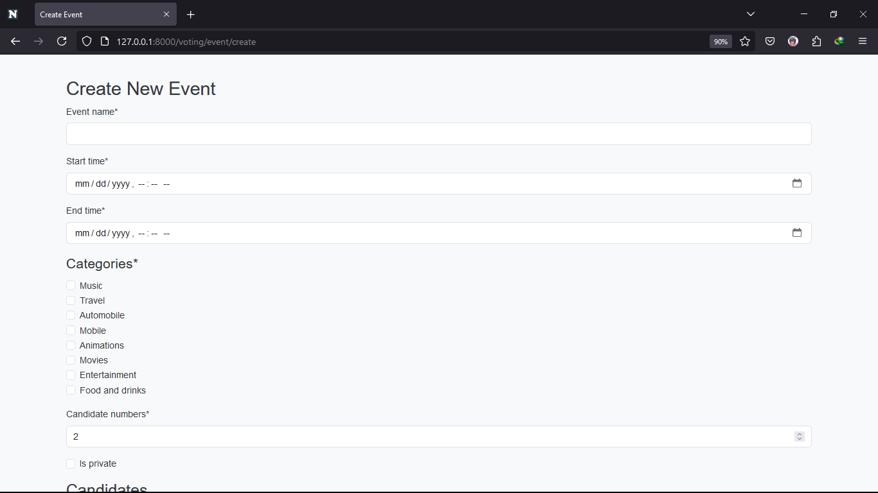
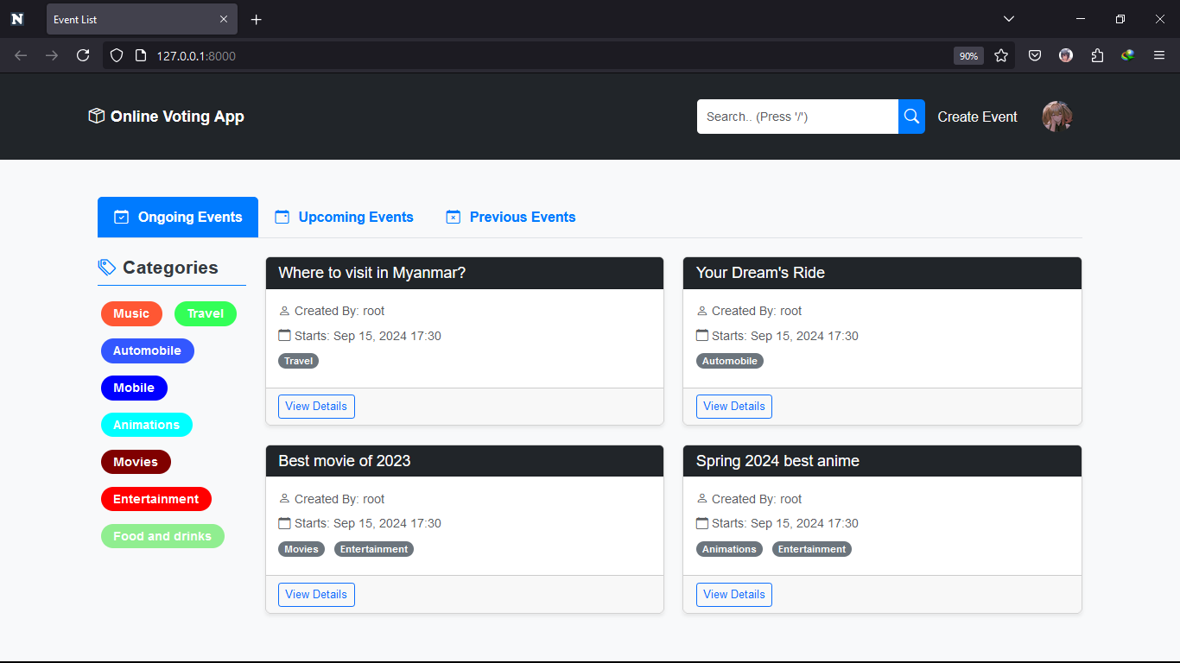
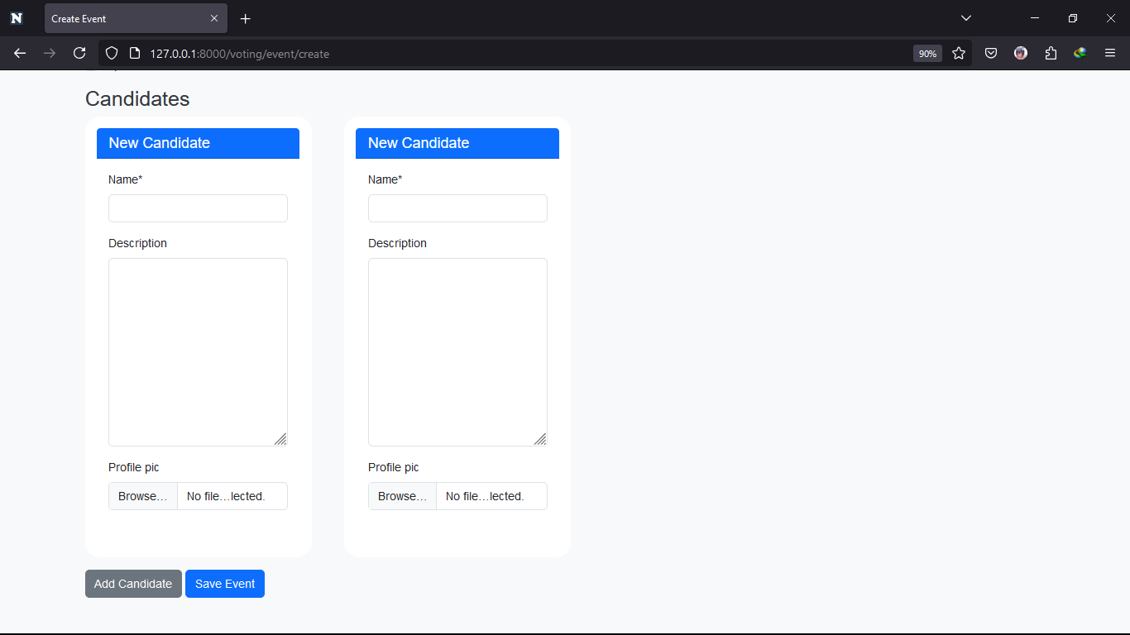
06 SNAPSHOTS AND DEMOS

Slide 12
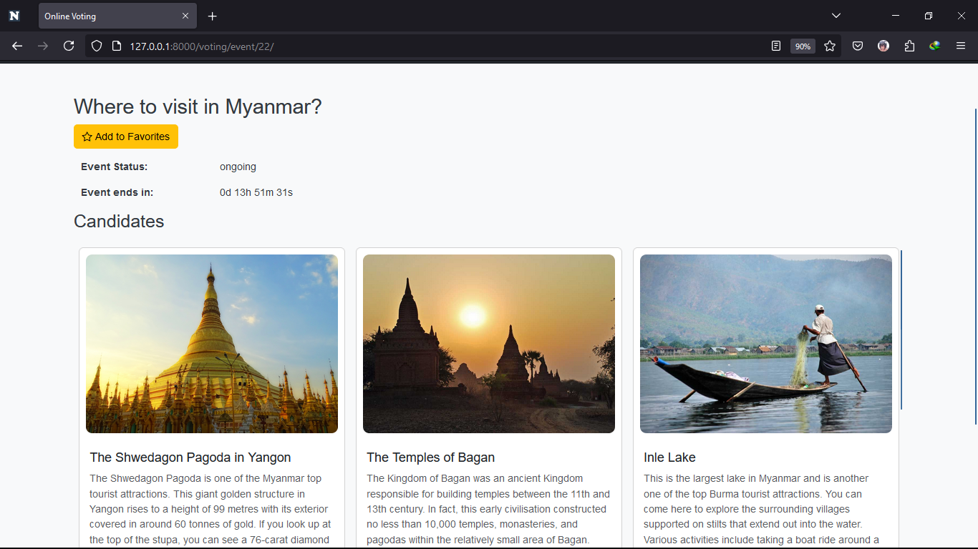
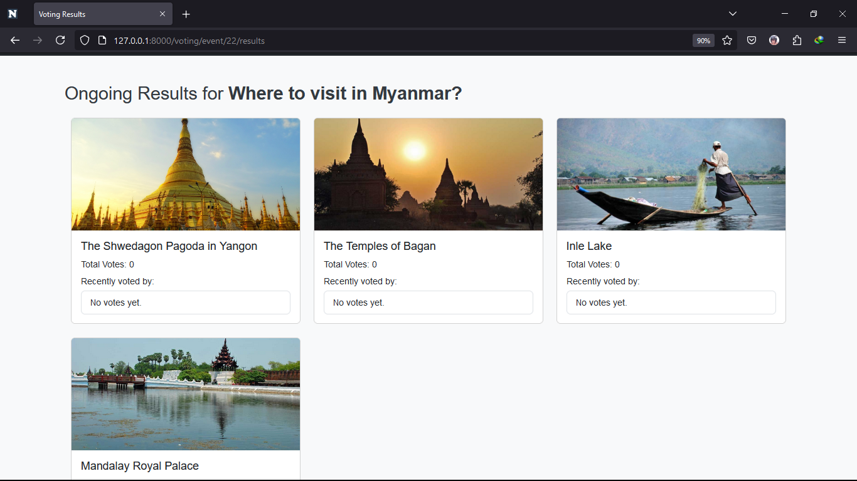
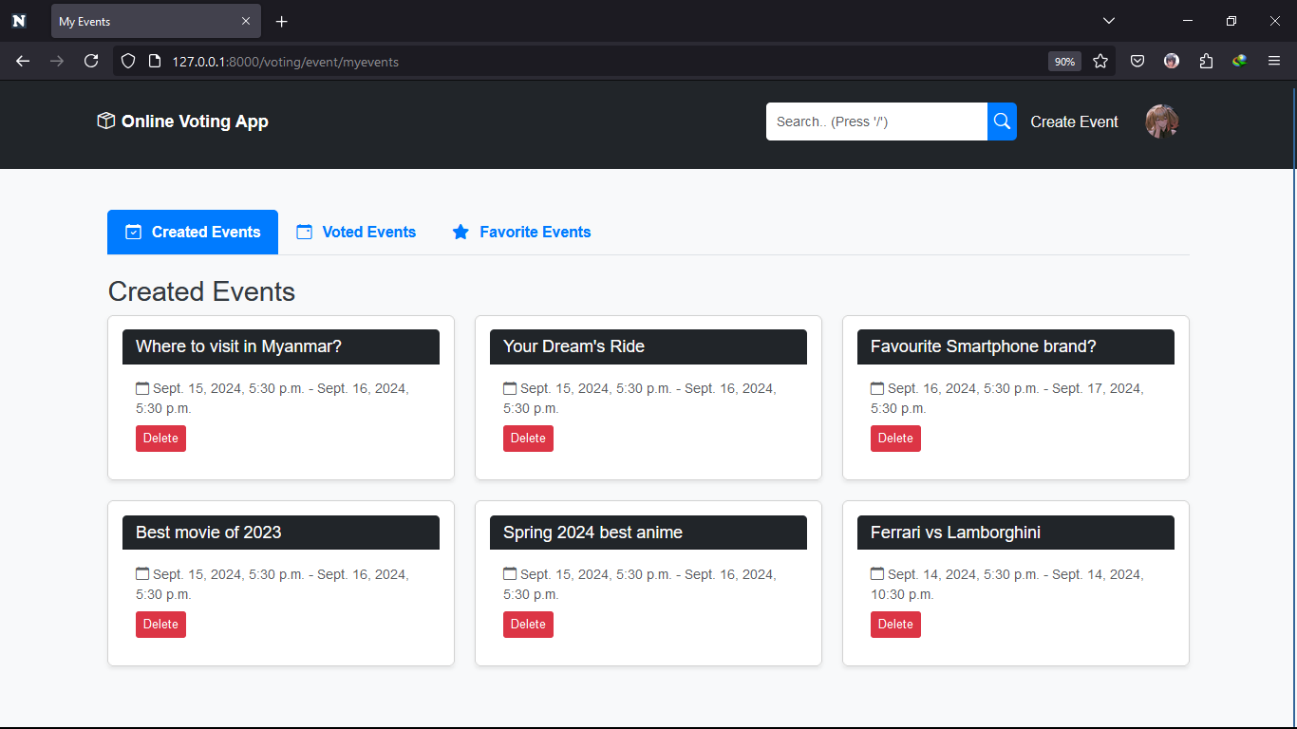

Slide 13
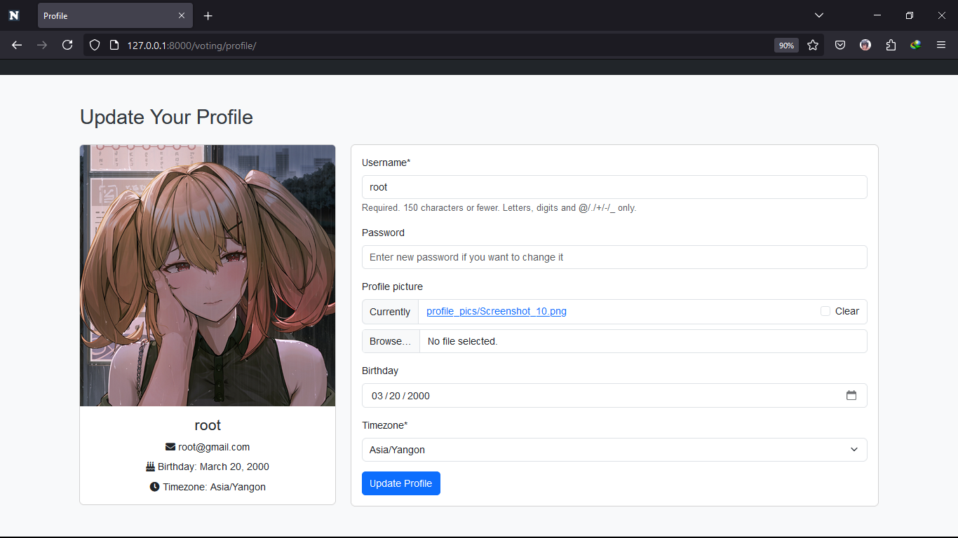
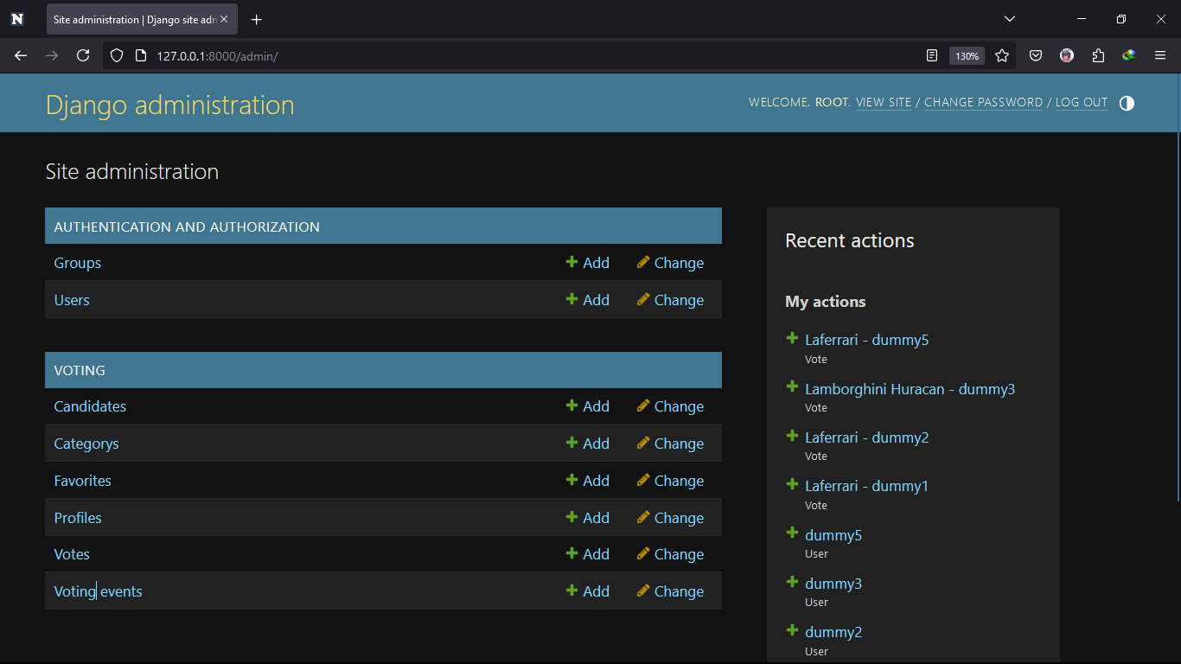

Slide 14
07 CONCLUSION
In conclusion, our project provides a user-friendly platform for a wide variety of users to create a voting event out of nowhere.
You can use it for fun or for other purposes, for example – research, survey, or problem solving.
If you have conflicts between two or more choices, just create a voting event and have others vote for you.
As long as there is a comparison to be made, you can create a voting out of it.

Slide 15
THAT IS FOR ALL. THANK YOU!

